Slide 1



Red vs Blue Team Simulation in Go
Title
Parimala Nagaraj
Akshara Tarikere
Shrey Jain
Nikhil Shinde
Prithvi Raj
"Protection of computer systems and data from digital threats."

Slide 2

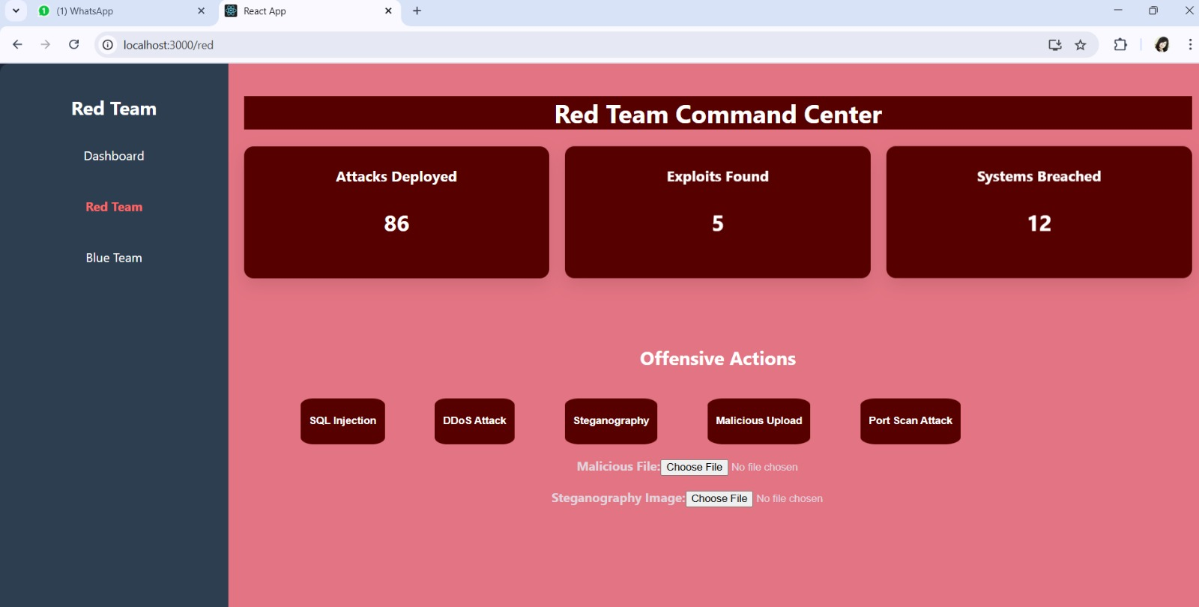
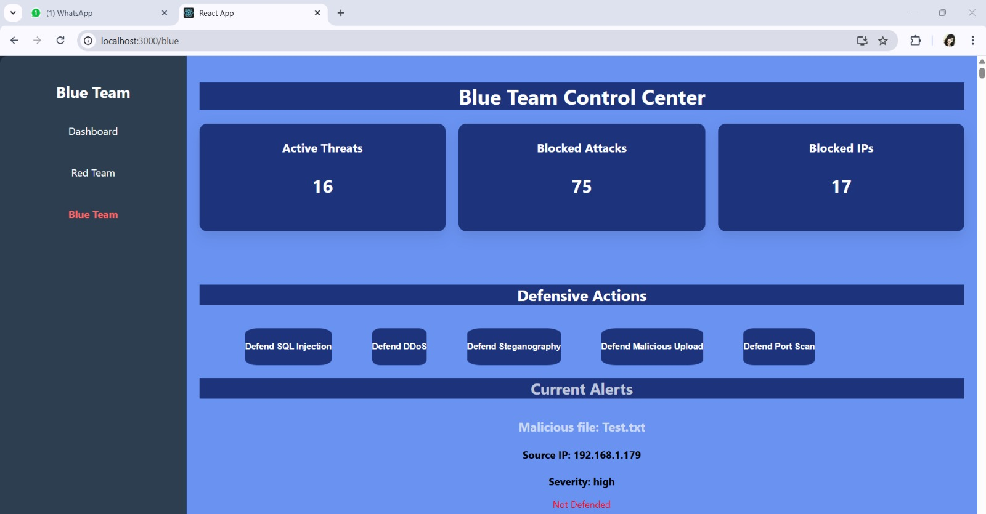
Overview
Designed and built a Red vs Blue Team simulation in Go with team, modeling real-world cyber attacks and defenses. Developed secure system architecture, implemented threat scenarios, and simulated defensive strategies in a controlled environment.

Slide 3
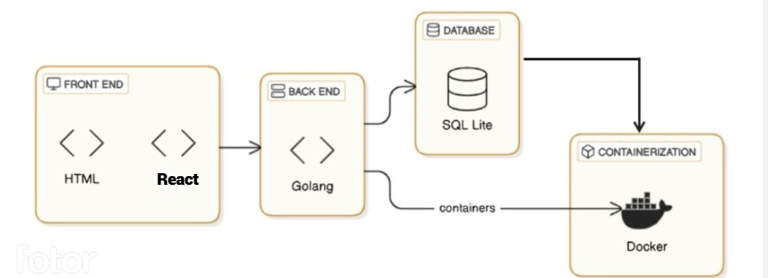
Tech Stack

Slide 4
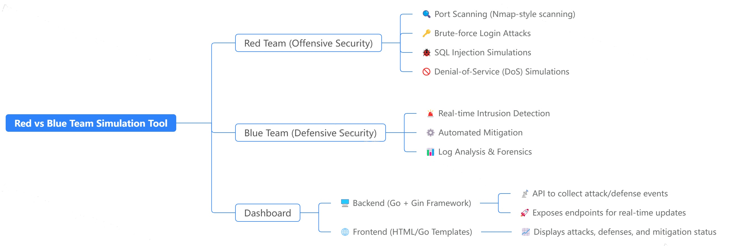
Flow

Slide 5
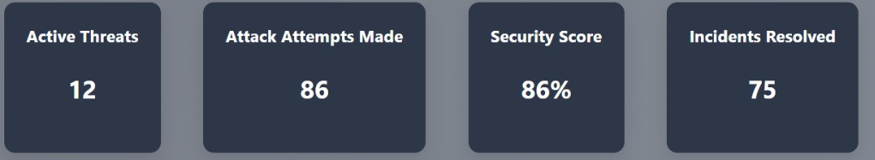
Dashboard Screen
Dashboard contains different metric to understand both team attack and defense.
Dashboard showing accumulated logs
Provides real-time security alerts from the Red Team via WebSocket.
Displays comprehensive alert details including severity, attack type, IP address, and status.
Shows all actions taken by the Blue Team, such as blocking attacks and defending ports.
Facilitates the analysis of attack handling by correlating alerts with Blue Team responses.

Slide 6
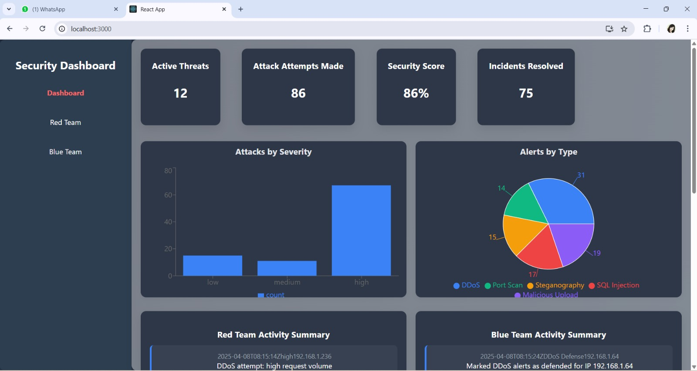
Dashboard Screen

Slide 7
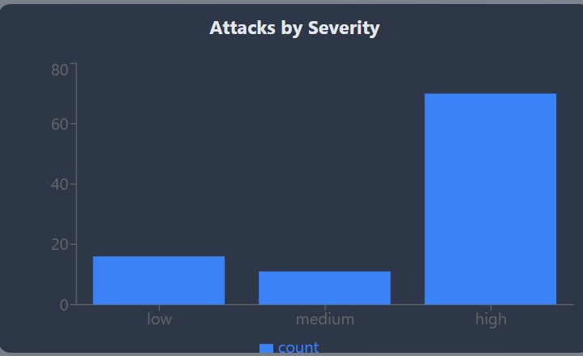
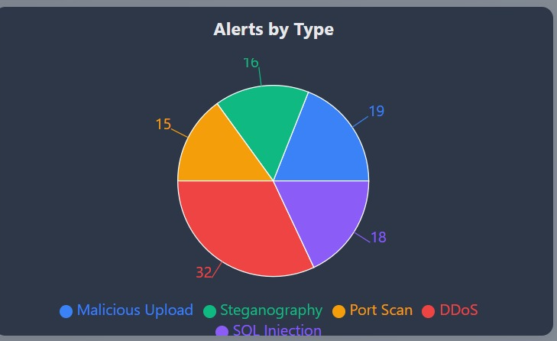
Severity Levels (Bar Chart):
High: 19 (e.g., SQL Injection, DDoS).
Medium: 15 (e.g., Malicious Uploads).
Low: 10 (e.g., Steganography).
Attack Types (Pie Chart):
DDoS: 32% | Port Scan: 18% | SQL Injection: 19% | Steganography: 15% | Malicious Upload: 16%.

Slide 8
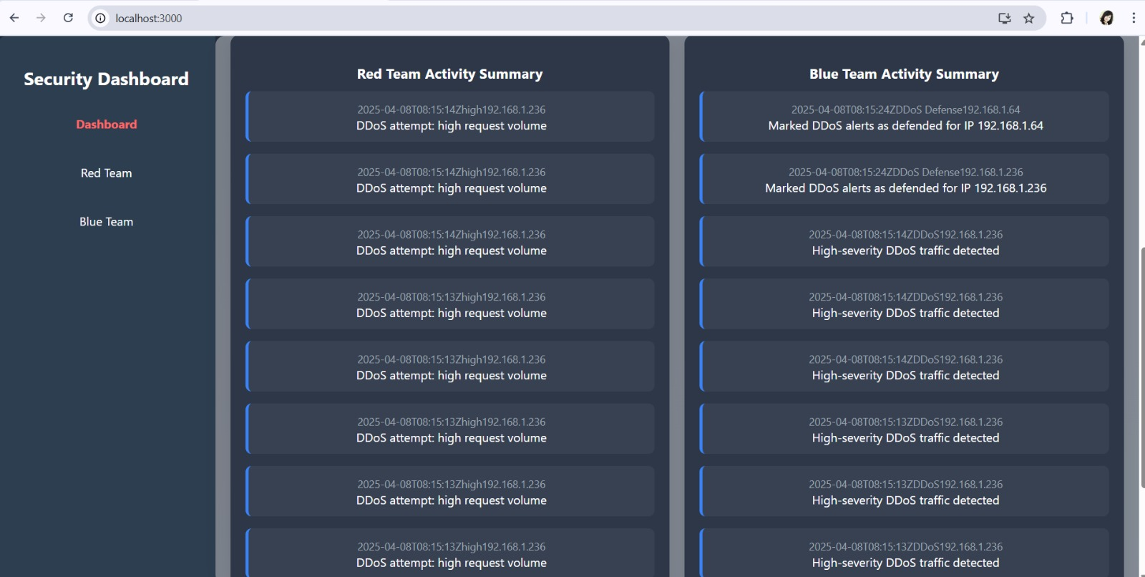
Summary Screen

Slide 9
Use Cases
Attack Type | Defense Mechanism | Logs/Actions
SQL Injection | Pattern matching + alert status update | Logs blocked the query attempt and marks harmful
Port Scan | Detect specific message & ports | Logs unsolicited connections and marks suspicious
Malicious Upload | File content scan + harmful payload detection | Blocks IP, logs payload, and marks harmful
DDoS | Rate limit by IP, tracks repeated requests | Blocks IP after multiple alerts
Steganography | Extracts payload from image and validates content | Logs hidden message, blocks sender IP

Slide 10
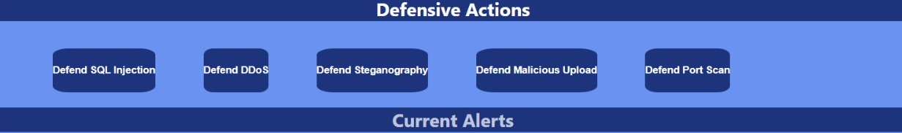
Blue Team
Blue Team has Defensive Actions, Live alert popup on Blue Team UI
Track attacker behavior
Blocked IPs
Log Incident
Key Defenses:
DDoS Mitigation: Blocked high-volume requests from 192.168.1.64.
Malicious File: Quarantined Text.txt (Contained virus TEST123).
Port Scan: Closed ports 3306, 5432, 1521.

Slide 11
Blue Team

Slide 12
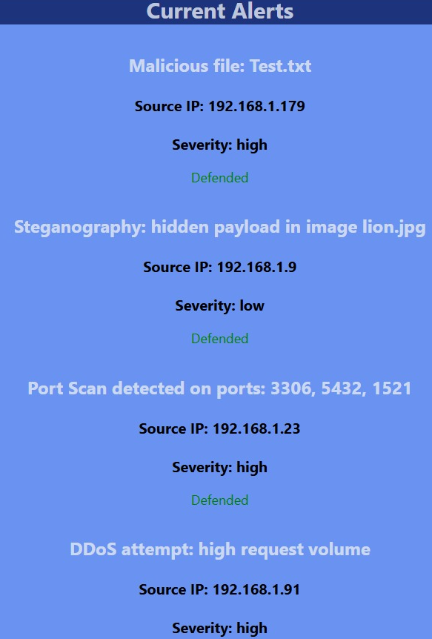
Simulation
Contains logs and Summary
Active Threats:
DDoS Attempt (IP 192.168.1.91): High severity – Pending action.
Malicious File: Test.txt – Defended.
Steganography: lion.jpg – Defended but low risk.
Lessons:
Strengths: Effective malware/quarantine processes.
Weaknesses: Slow DDoS response; need automated IP blocking.

Slide 13
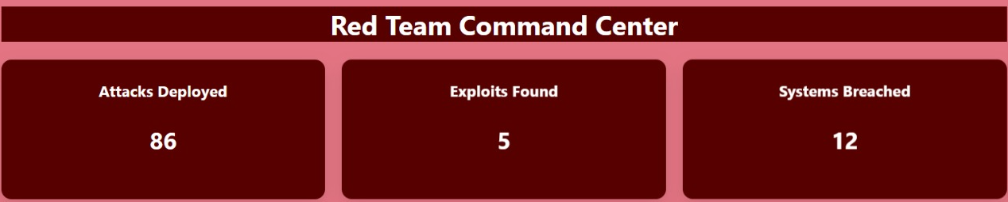
Red Team
Red Team has offensive actions SQL Injection, DDoS, Port Scanning, Steganography, Malicious Upload
Each attack triggers and logs events.
Key Attacks:
SQL Injection (IP 192.168.1.41): Attempted database breach.
Port Scan (IP 192.168.1.23): Scanned ports 3306, 5432, 1521.
Steganography: Hid data in lion.jpg (Found: SECRET-4391).

Slide 14
Red Team

Slide 15
Go Features/Functionality
Concept/Feature | Used In
Goroutines + Mutex + WaitGroup | DDoS defense concurrency
HTTP Routing + Handlers | All API endpoints
WebSocket (gorilla/websocket) | Real-time alerting Red Blue,dashboard
SQL Transactions | Stego & Malicious Upload defenses , sql , blockips, mark defense , alerts
Byte Manipulation | Steganography payload embedding/extraction
File Upload Handling | Malicious file + stego image attacks
JSON Encoding/Decoding | REST API & WebSocket messages
Environment Variables | Dynamic Blue/Red/Dashboard Team URL setup
String Matching | Defense pattern detection
Random Data Generation | attack simulation (IP, payloads), etc

Slide 16

Conclusion
We plan to expand this project into open-source platform for Red and Blue Team learning, with future integration of diverse testing environments like Kali Linux.
Thank You

